Slide 1
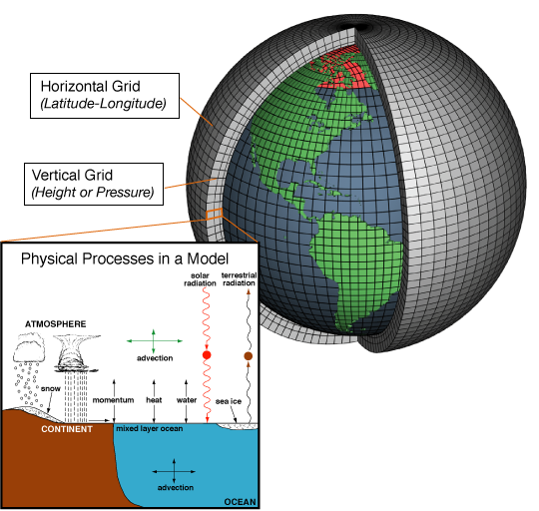
GCMs separate the world into grid cells

Slide 2
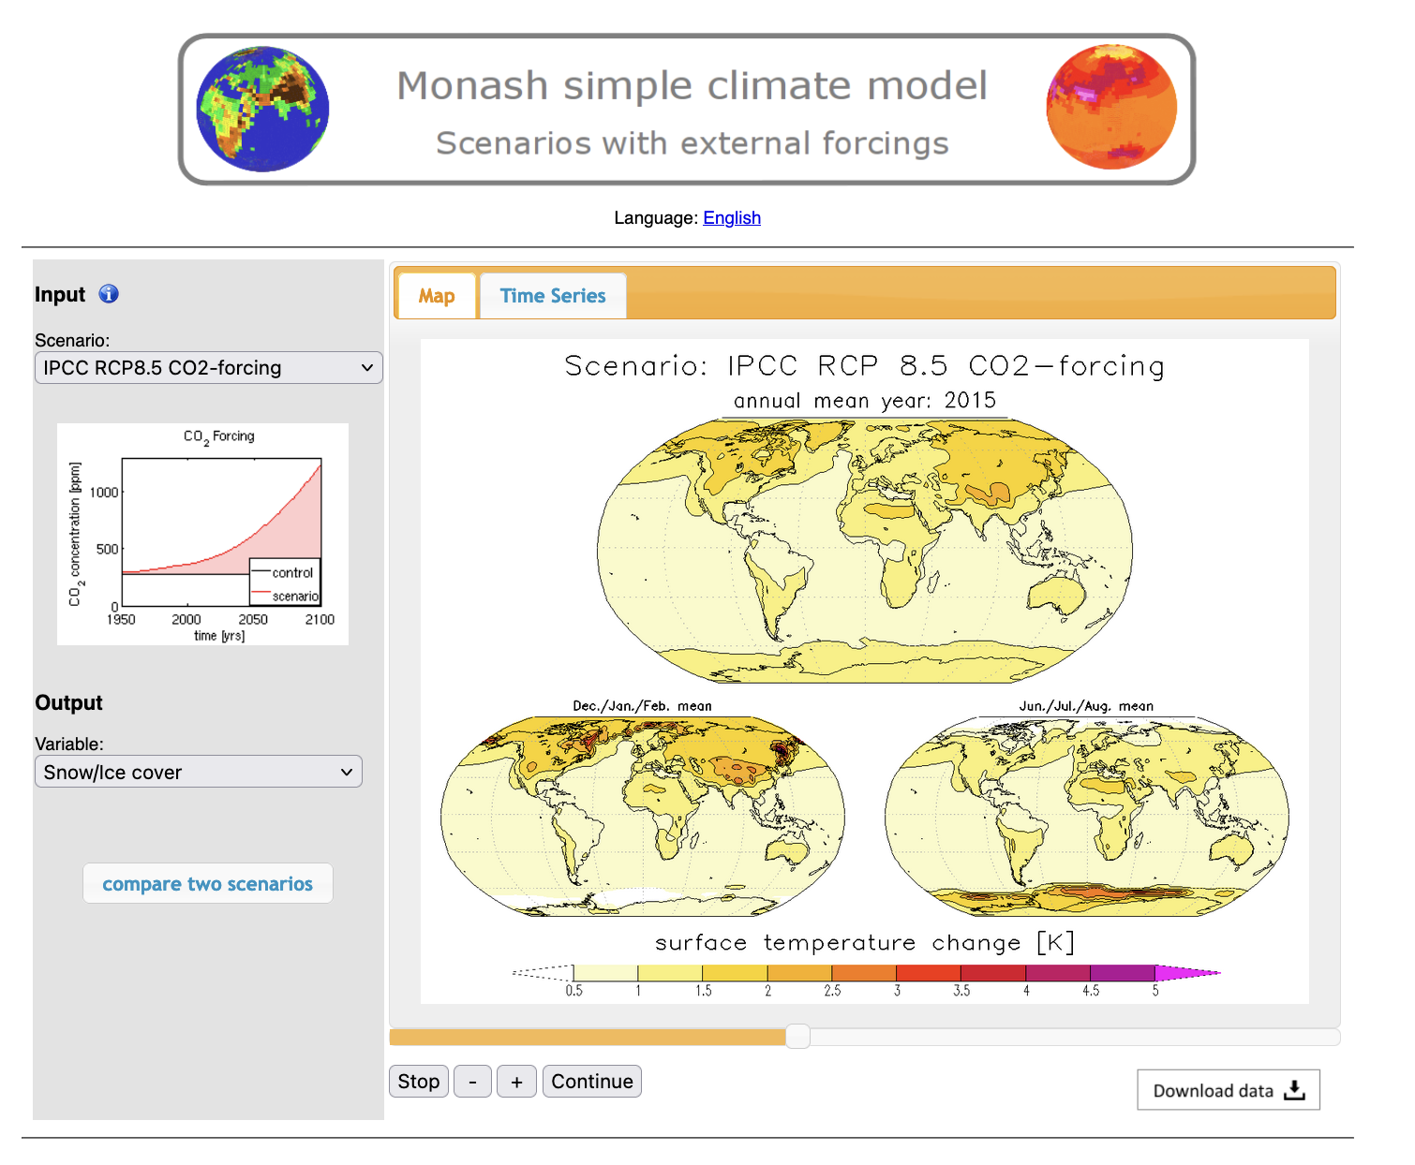
Survey of RCP (“Representative Concentration Pathway) predictions
Study all combinations of:
All four RCP scenarios (IPCC RCP2.6 CO2-forcing to IPCC RCP8.5 CO2-forcing), as well as 2x CO2 forcing)
Variables: Surface Temperature and Snow/Ice cover
Map and Time Series (e.g., in the Map, are there parts of the world that are warming faster than others?)
For IPCC RCP2.6 CO2-forcing, calculate the Equilibrium Climate Sensitivity.
Document in your research notebook

Slide 3
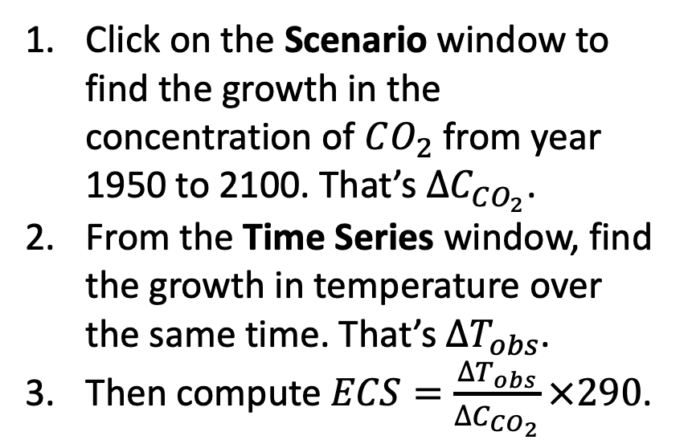
Calculating the Equilibrium Climate Sensitivity (ECS) in Monash
Click on the Scenario window to find the growth in the concentration of $CO_{2}$ from year 1950 to 2100. That’s $∆C_{CO_{2}}$.
From the Time Series window, find the growth in temperature over the same time. That’s ${∆T}_{obs}$.
Then compute $ECS=\frac{∆T_{obs}}{∆C_{CO_{2}}}×290$.

Slide 4
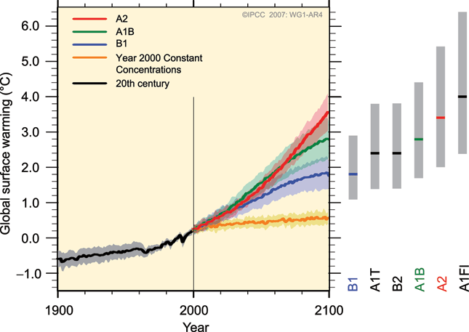
The idea is that you’ll get familiar with each of the RCP scenarios
Monash GCM runs will not tell us about uncertainties in these predictions, unfortunately.
https://en.wikipedia.org/wiki/File:Global_mean_near-surface_air_temperature_and_thermosteric_sea-level_rise_anomalies_relative_to_the_2000%E2%80%932019_mean_for_RCP_climate_change_scenarios.webp

Slide 5
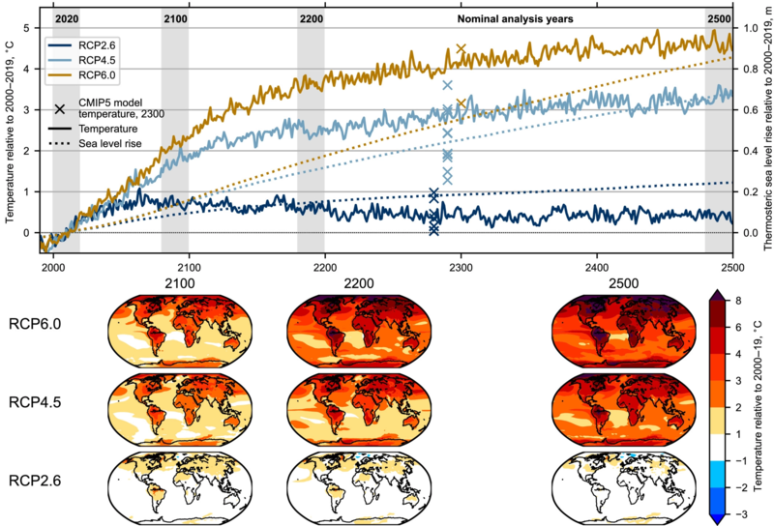
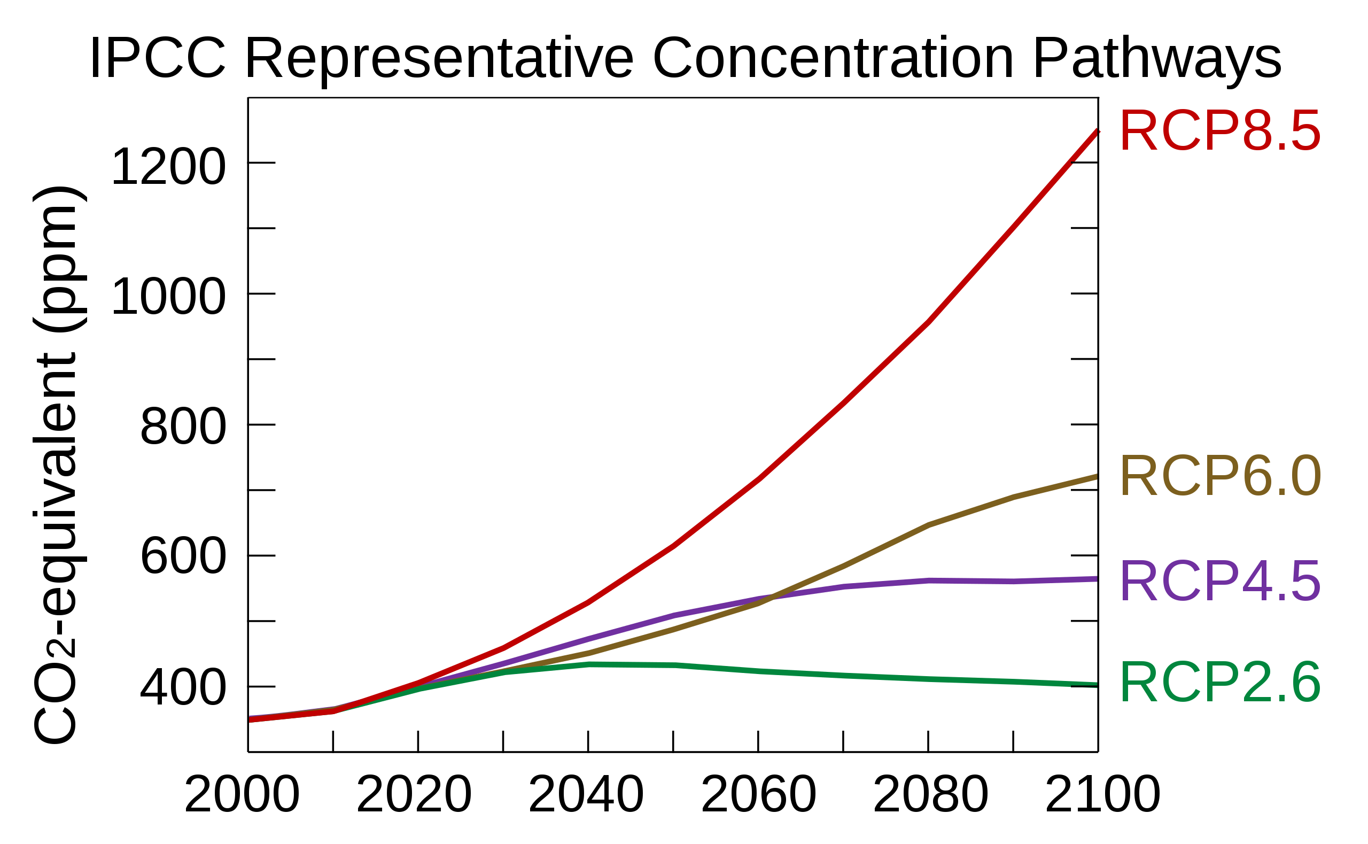
Also, the world will go on past the year 2100
https://en.wikipedia.org/wiki/File:Global_mean_near-surface_air_temperature_and_thermosteric_sea-level_rise_anomalies_relative_to_the_2000%E2%80%932019_mean_for_RCP_climate_change_scenarios.webp

Slide 6
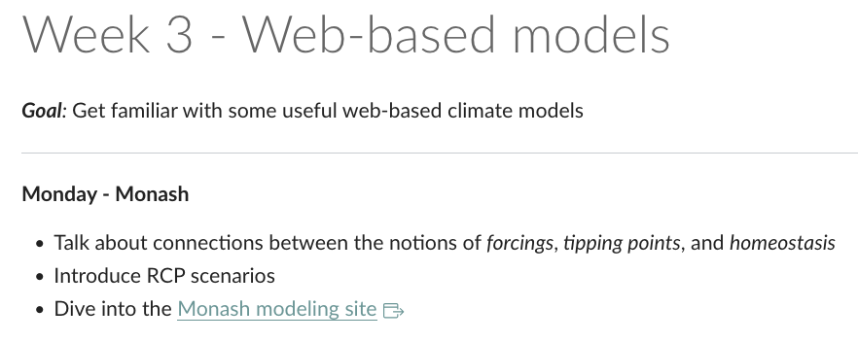
OK, let’s get started!

